Slide 1
Quantum Computing
A presentation by Daniel Easteal

Slide 2
Outline
What is quantum computing?
Why I am passionate about it?
How it impacts people.
Security is important!

Slide 3
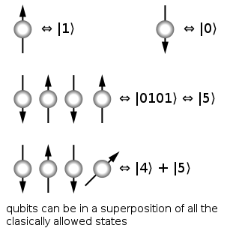
Quantum computing…what is it?
Entirely different to classical computing
Superposition of particles
Computing with qubits rather than bits
Returns a probability that can be used as an answer
Designed mainly for minimisation

Slide 4
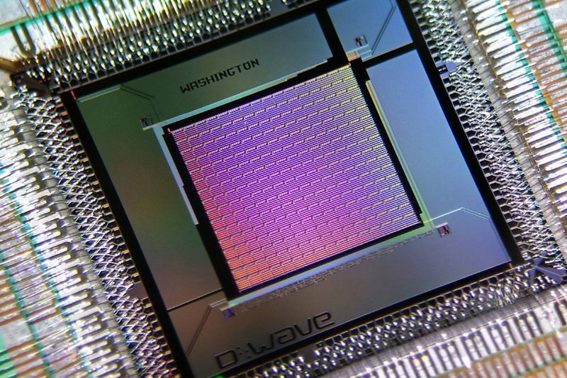
Why I am passionate about this…
Changes how computation can be done
Huge, currently undiscovered potential
Seems futuristic but it actually exists

Slide 5

How it impacts me
Labelling News Stories
All news stories and images need category labels
Uses the REUTERS and SCENE corpus
“We found that our approach worked extremely well on these problems” - Dwave
“ [Dwave] provided better labeling accuracy than a state of the art conventional approach.”- Dwave
Source: https://www.dwavesys.com/quantum-computing/applications

Slide 6
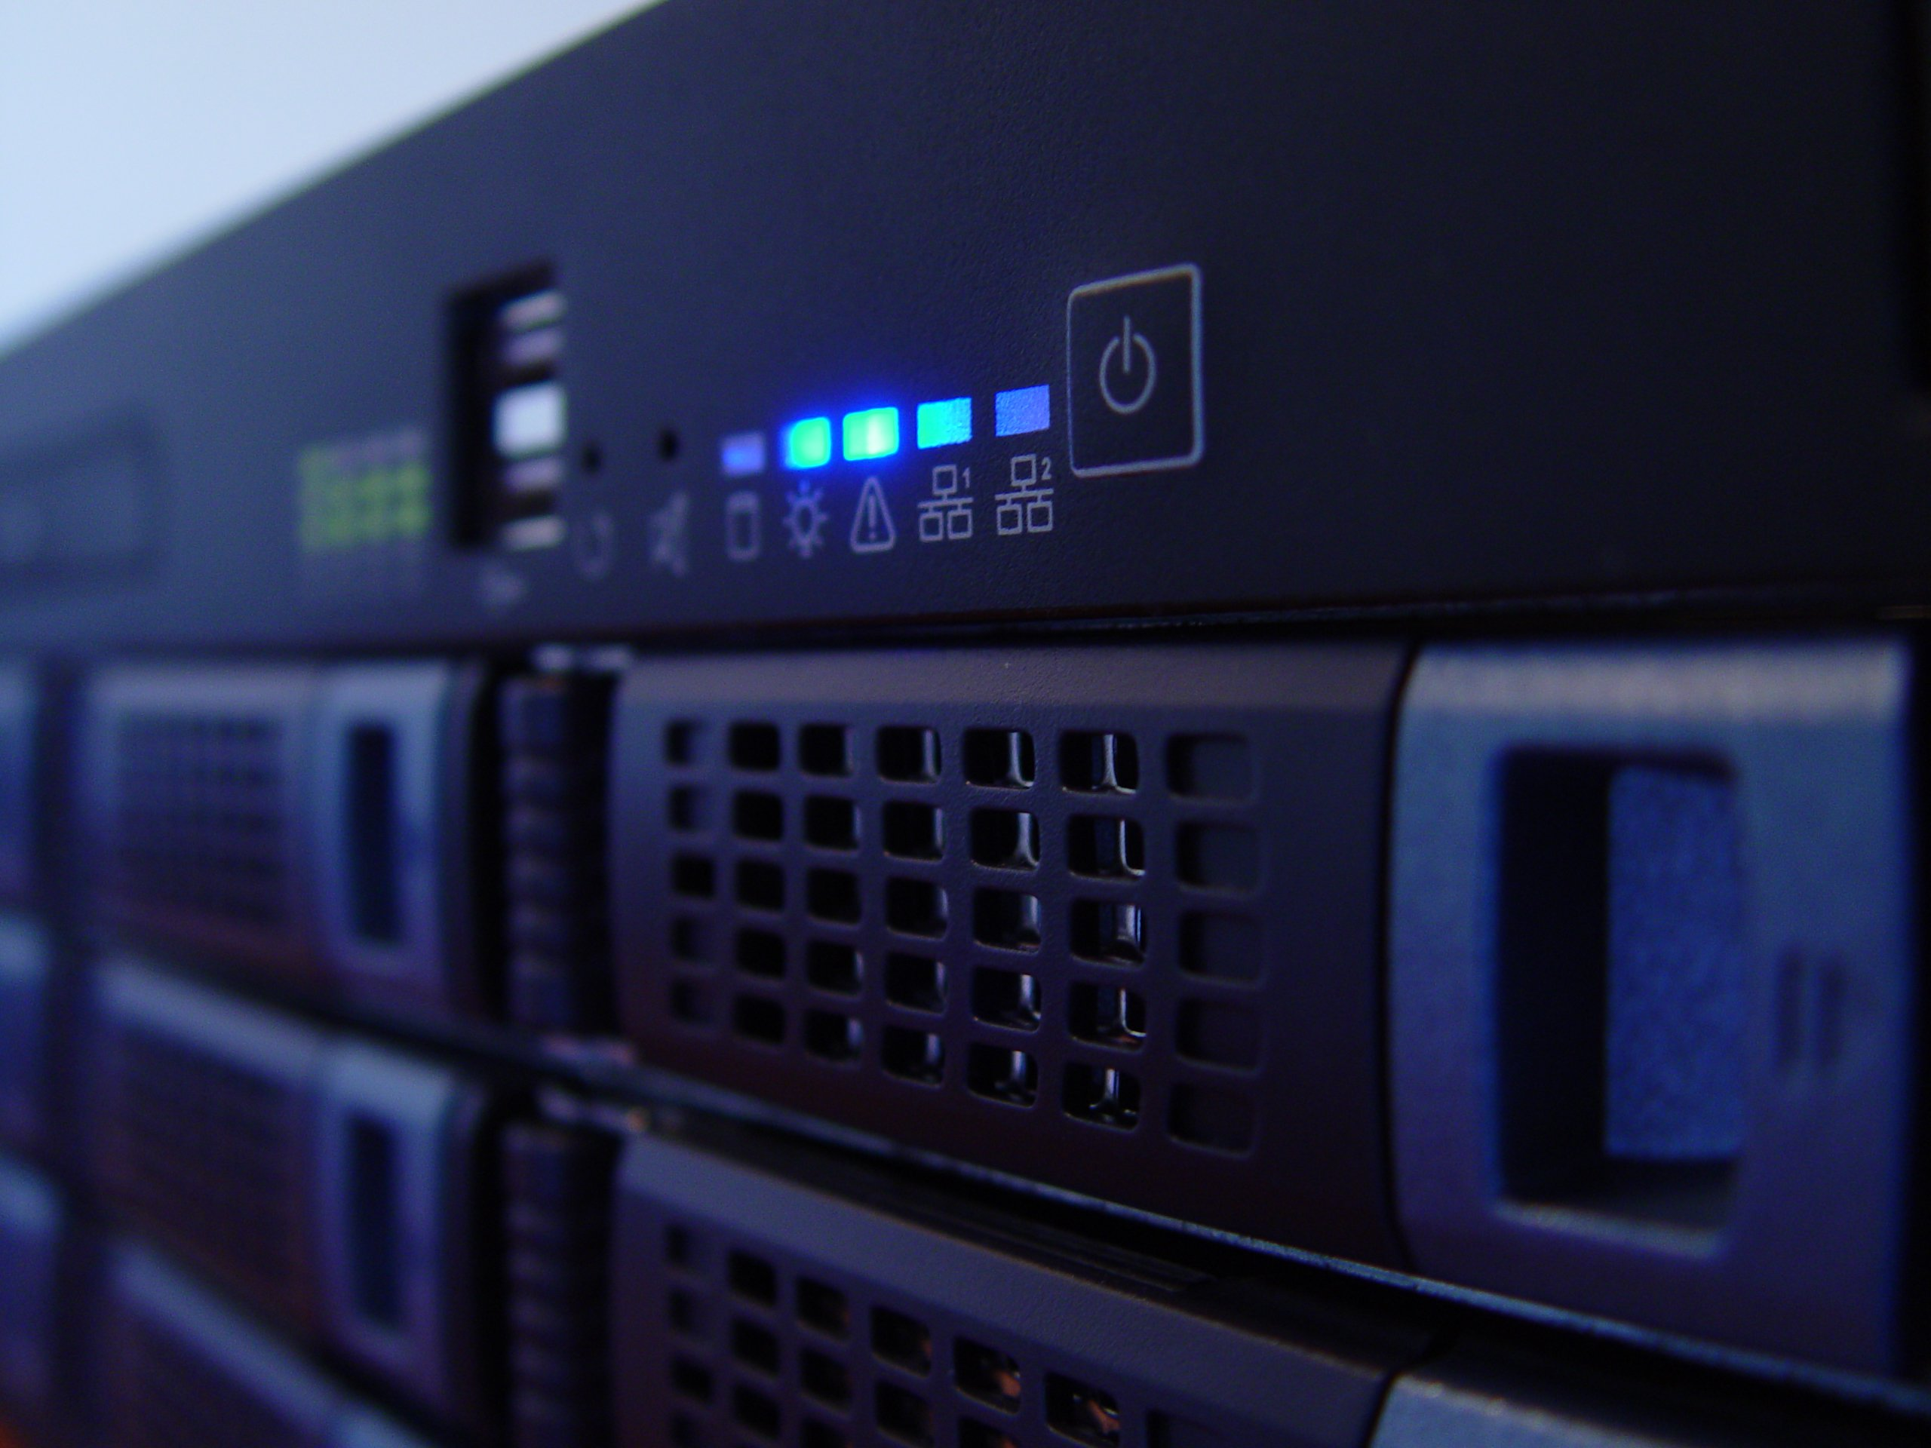
How it impacts businesses
Finance and Trading
Used by Guggenheim Partners
Risk modelling and market instabilities are essential
“We can build an optimal portfolio today, but tomorrow it won't be optimal and needs to be rebalanced, which is expensive” - Marcos Lopez de Prado senior managing director at Guggenheim Partners.
Source: http://www.bbc.co.uk/news/business-35886456

Slide 7
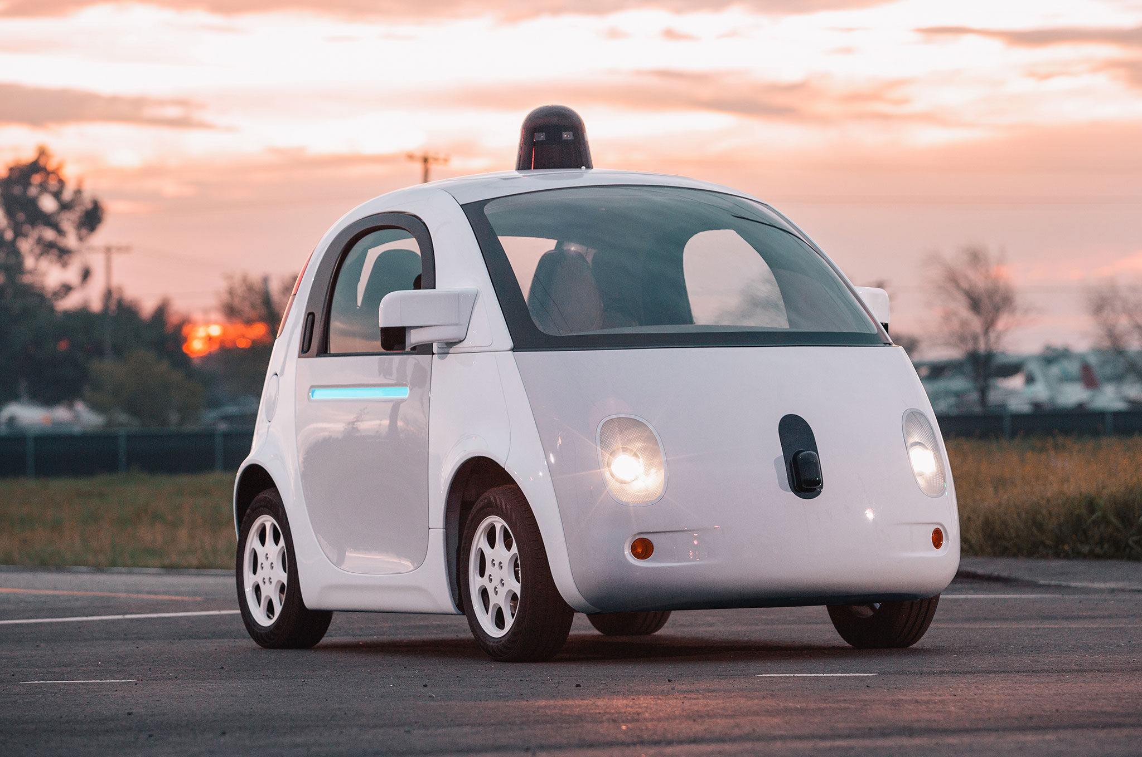
How it impacts society
Self driving cars
Google mainly use quantum computers
Self driving cars need to identify things it can see
“Google has shown the D-Wave can significantly outperform on traditional chips” - wired
Source: https://www.wired.com/2015/12/for-google-quantum-computing-is-like-learning-to-fly/

Slide 8

Security is important!
Quantum computers can easily solve encryption
Grover's algorithm
Can easily be used incorrectly
They need to be securely accessed

